Slide 1







Bitcoin
₿6.15
@anilsaidso
Terminology

Slide 2


Contents
Bitcoin
Lightning Network N.O.S.T.R.
₿

Slide 3










₿6.15
@anilsaidso
1
2
3
bitcoin
money
the network
connected nodes
the blockchain
linked record of verified tx’s

Slide 4










@anilsaidso
₿6.15
bitcoin
money
1
2
3
the network
connected nodes
the blockchain
linked record of verified tx’s

Slide 5
bitcoin
out of 21M total units
@anilsaidso
₿6.15
unit of account
native to the bitcoin blockchain
=15,000,000
satoshis

Slide 6
satoshi
@anilsaidso
100,000,000
sats
A bitcoin is divisible into 100 million smaller units called satoshis (or sats)
1 BTC

Slide 7
terminal supply
@anilsaidso
90%
The maximum amount of bitcoin that will ever exist once all has been mined
₿0
₿21M

Slide 8

supply schedule
@anilsaidso
₿21M
pre-programmed timetable for issuance of new bitcoin
₿0
2009
2022

Slide 9
₿50
₿25
@anilsaidso
halving
every 210,000 blocks (~4yrs), the rate of new bitcoin issued per block is reduced by 50%
₿12.5
₿6.25
₿3.125

Slide 10
₿6.15
@anilsaidso
the network
connected nodes
1
2
3
bitcoin
money
the blockchain
linked record of verified tx’s

Slide 11
bitcoin’s network
@anilsaidso
connected nodes following a common set of rules

Slide 12



bitcoin software
@anilsaidso
Download
open-source software that codifies the ruleset
Bitcoin Core 22.0

Slide 13

full node
@anilsaidso
Running Bitcoin
runs bitcoin software
maintains a complete copy of the blockchain
enforces the network’s rules
3
2

Slide 14

light client
@anilsaidso
connects to a full node to interact with the network
stores only partial records to save on disk space

Slide 15

₿6.15
@anilsaidso
1
2
3
bitcoin
money
the network
connected nodes
the blockchain
linked record of verified tx’s

Slide 16
block
@anilsaidso
2
time-stamped batch of confirmed transactions
every 10 minutes on avg.
Tx 1
Tx 2
Tx 3

Slide 17
bitcoin’s blockchain
@anilsaidso
sequentially-linked blocks
historical record of all confirmed transactions
1
2
3
confirmed blocks

Slide 18

Merkle tree
@anilsaidso
Root Hash
data structure that helps reduce storage space and easily prove transaction validity
Hash (1,2)
Hash (3,4)
Hash (1)
Hash (2)
Hash (3)
Hash (4)
Tx 1
Tx 2
Tx 3
Tx 4

Slide 19


Tx 1
Hash (1)
@anilsaidso
transaction
transfer of ownership of bitcoin between network participants
cryptographically signed by the sender
₿0.15

Slide 20


Lightning
Network
Basics
@anilsaidso

Slide 21
Lightning Network
Protocol enabling scalability via instant off-chain payments.
Liquid, federated side-chains, etc.
2nd layers (off-chain)
Lightning Network
Other
Base layer (on-chain)
Bitcoin Protocol
@anilsaidso

Slide 22
Lightning Network
Payment Layer
Routing Layer
P2P Layer
Messaging Layer
Network Connection Layer
The LN protocol suite is comprised of five layers
@anilsaidso

Slide 23



Lightning Node
Hardware that runs specific software to connect to (and interact with) the Lightning Network.
@anilsaidso

Slide 24





Lightning Wallet
A lightning wallet is always online. It should not be used to store large amounts.
Savings
2.56
745,000
Spending
@anilsaidso

Slide 25

Payment Channel
Financial relationship between
two nodes
Locked:
75,000 sats
Locked:
75,000 sats
Total Channel Capacity:
150,000 sats
@anilsaidso

Slide 26




Multisignature
Balance:
150,000 sats
A payment channel requires the signatures of both participants
(2-of-2) for opening and final settlement on the bitcoin blockchain.
@anilsaidso
2 of 2

Slide 27


Off-chain Transactions
An on-going tab between two participants, eventually being settled on the bitcoin blockchain to close the tab.
Funding Tx (on-chain)
Commitment Tx’s Tx 1 Tx 2 Tx 3
Closing Tx (on-chain)
@anilsaidso

Slide 28





Payment Routing
Lightning payments between non-channel partners must be forwarded (routed) to their final destination.

Slide 29


Locked:
75K sats
Locked:
75K sats
Locked:
25K sats
Locked:
25K sats
5K sats
@anilsaidso
5K sats
5K sats
-5K sats
+5K sats

Slide 30

NOSTR
Basics
@anilsaidso

Slide 31
N.O.S.T.R.
Notes and Other Stuff Transmitted by Relays
An open protocol for censorship-resistant communication
networks created by @fiatjaf
@anilsaidso

Slide 32
WHAT MAKES UP
Users
Events
Relays
NOSTR
Clients

Slide 33


Users
Similar to the bitcoin protocol, nostr is permissionless.
@anilsaidso
Public Key
Like a username, it’s how others can find you.
Private Key
Like a password, it’s used for signing messages to prove authenticity.
*DO NOT SHARE
To use the protocol a user generates a key pair: public key & private key

Slide 34

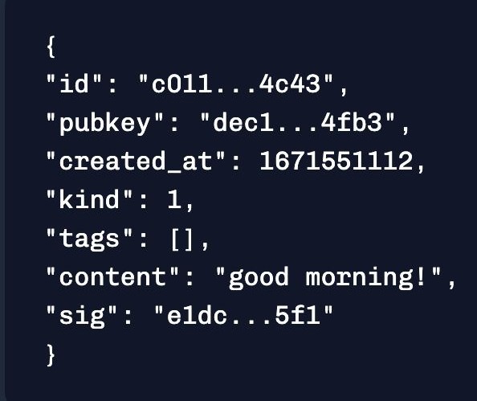
Events
@anilsaidso
Nostr is a protocol for packaging simple text-based objects.
These are called events.

Slide 35
Anatomy of an Event
@anilsaidso
Event’s unique
identifier
User
Timestamp
Type of event (e.g. plain text note, E2E msg, etc.)
Tags
(e.g. specify post as a reply
to event XYZ)
Proof of authenticity
(signed with user’s private key)
Message

Slide 36

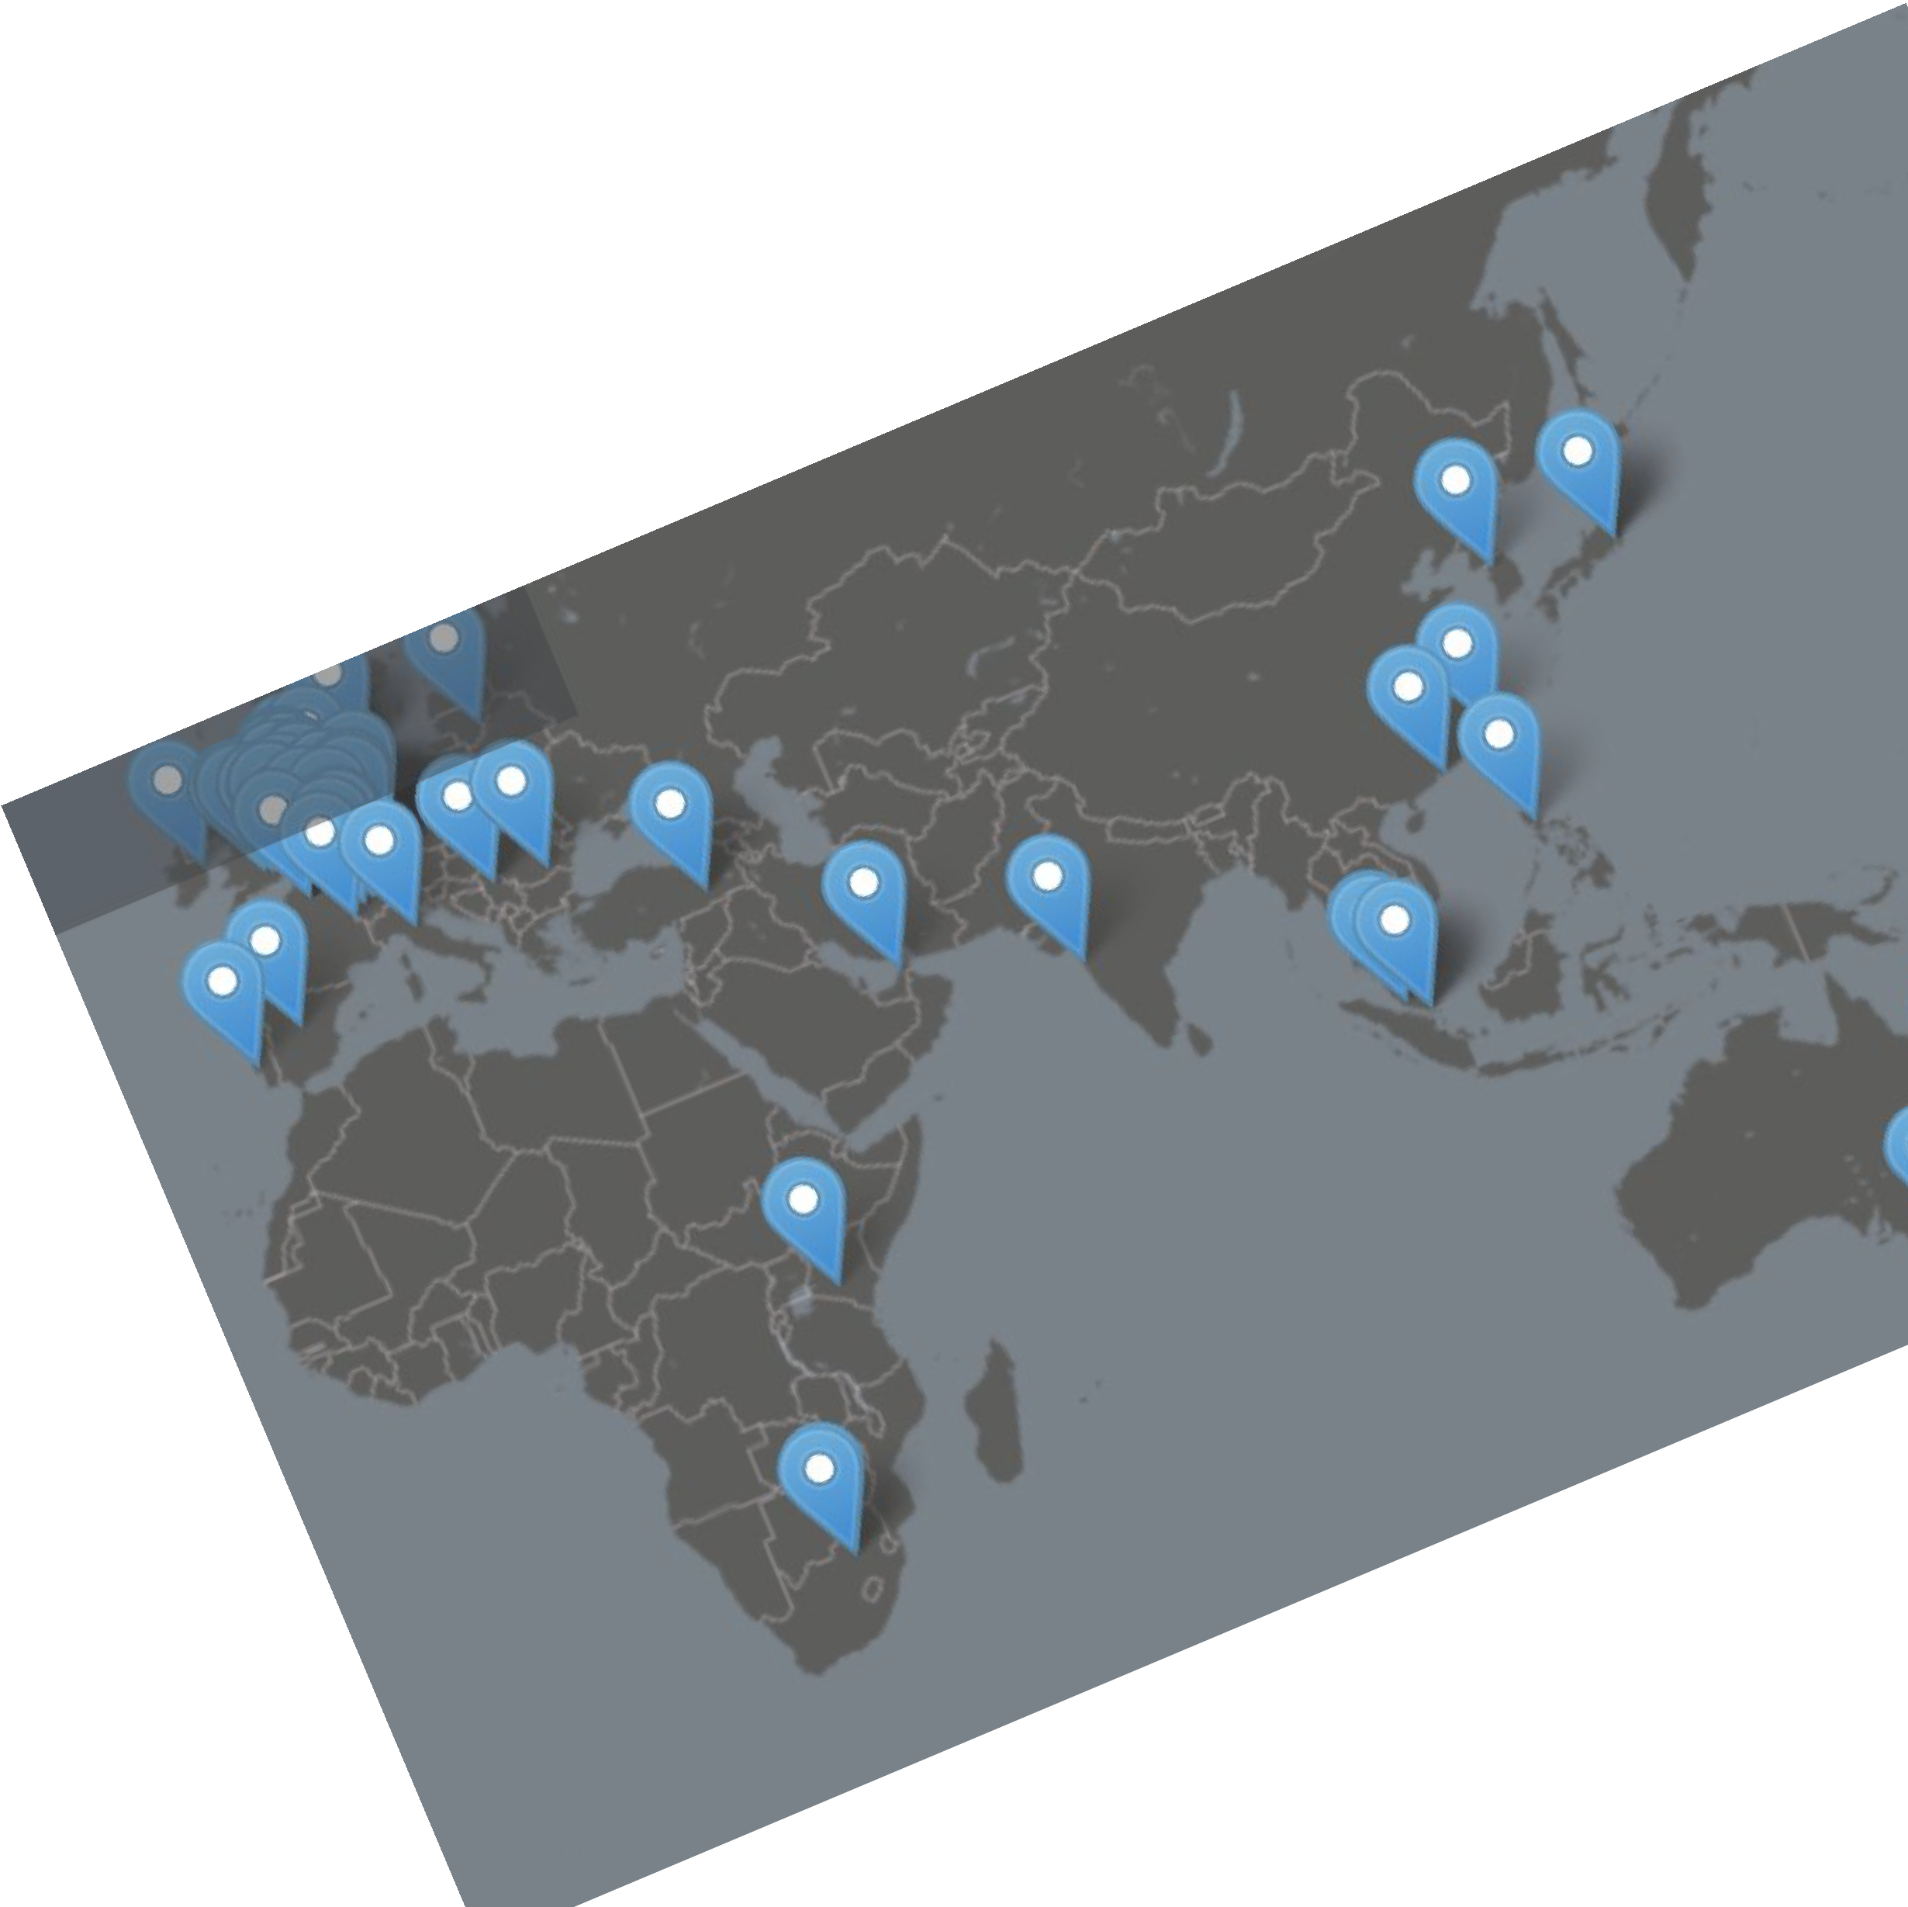
Relays
@anilsaidso
Posting content is not broadcast to all users, nor sent directly to a particular recipient (P2P).
Instead, it is sent to a relay server, readable by users also connected to that common relay.
Relays can be public/private, free/paid, or application-specific.

Slide 37




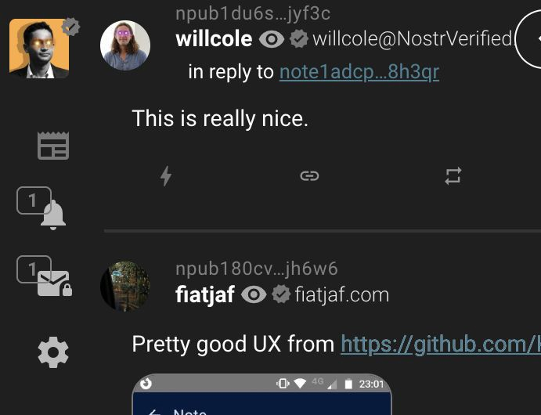
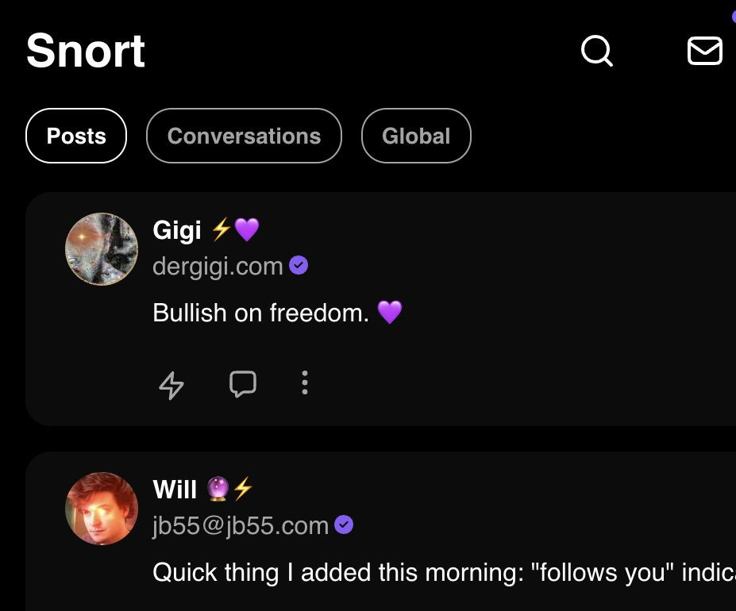
Clients
@anilsaidso
Mobile
Users interact with the nostr protocol through a client.
Web (browser)
You can use any client you wish or even build your own.

Slide 38





Zaps
@anilsaidso
As an open protocol, Nostr is interoperable with other open protocols such as Lightning.
When using compatible clients, users can show their appreciation for content by zapping a post (tipping in bitcoin).
Balance
65,000

Slide 39


Anil
@anilsaidso

